Slide 1
Unit 7 Visible-Surface Detection Methods
(Hidden Surface Removal Method)

Slide 2
Introduction
Hidden-surface elimination methods
Identifying visible parts of a scene from a viewpoint
Numerous algorithms
More memory - storage
More processing time – execution time
Only for special types of objects - constraints
Deciding a method for a particular application
Complexity of the scene
Type of objects
Available equipment
Static or animated scene
<Ex. Wireframe Displays>

Slide 3
Classification of Visible-Surface Detection Algorithms
Visible surface detections are broadly classified according to whether they deal with object definitions directly or with their projected images. These two approaches are called object-space methods and image-space methods. They are described below.

Slide 4
Object-space methods:
–Compare the actual 3d representations with each other within the scene to decide visibility.
–Calculations are done without regard to a particular display resolution.
• Image-space methods:
–Decide visibility by looking point by point at each pixel position on the projection plane.
–Performed at the resolution of the display device.
–Simple, fast and works on any 3d object.
–Most visible surface detection algorithms use this method.

Slide 5
Sorting and Coherence Methods
To improve performance
Sorting
Facilitate depth comparisons
Ordering the surfaces according to their distance from the viewplane
Coherence
Take advantage of regularity

Slide 6
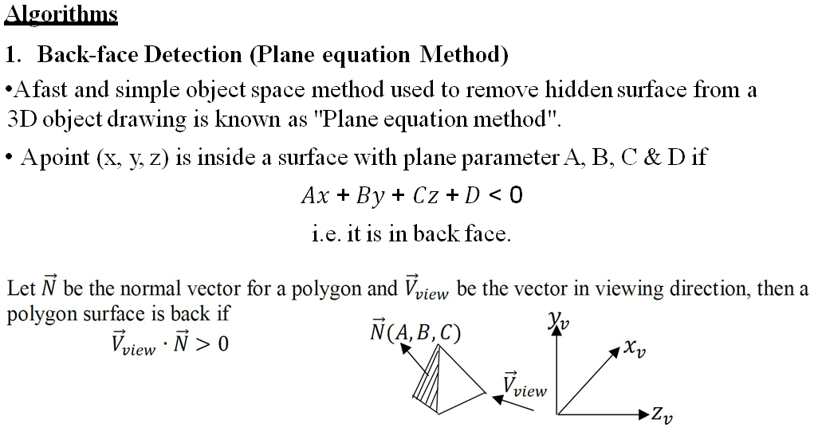

Slide 7
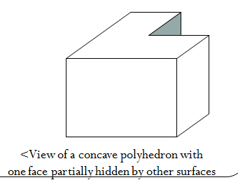
For the left handed viewing system if the ‘z’ component of the normal vector is positive, then it is back face. If the ‘z’ component of the vector is negative then it is a front face.
For the right handed viewing system if the ‘z’ component of the normal vector is negative, then it is back face. If the ‘z’ component of the vector is positive then it is a front face.
Limitations:
This method works fine for convex polyhedral, but not necessarily for concave polyhedral or overlapping objects. So, we need to apply other methods to further determine where the obscured faces are partially or completely hidden by other objects (e.g. Using Depth-Buffer Method or Depth-sort Method).
This method can only be used on solid objects modeled as a polygon mesh.

Slide 8
Depth-Buffer (Z-Buffer)Method

Slide 9
Characteristics
Commonly used image-space approach
Compares depths of each pixel on the projection plane
Referred to as the z-buffer method
Usually applied to scenes of polygonal surfaces
Depth values can be computed very quickly
Easy to implement
Two buffer areas are required
Depth buffer
Store depth values for each (x, y) position
We can implement the depth-buffer algorithm in normalized coordinates, so that z values range from 0 at the back clipping plane to z_{max} at the front clipping plane
Refresh buffer
Stores the intensity values for each position
All positions are initialized to the background intensity

Slide 10
Initially, all positions in the depth buffer are set to 0 (minimum depth) and the refresh buffer is initialized to the background intensity.
Each surface listed in the polygon tables is then processed, one scan line at a time, calculating the depth (z value) at each (x, y) pixel position. The calculated depth is compared to the previously stored in the depth buffer at that position.
If the calculated depth is greater than the value stored in the depth buffer, the new depth value is stored, and the surface intensity at that position is determined and placed in the same xy location in the refresh buffer. Depth values for a surface position (x, y) are calculated from the plane equation for each surface:

Slide 11
Depth-Buffer Methods
view plane
Three surfaces overlapping pixel position (x,y) on the view plane. The visible surface, S₁, has the smallest depth value.

Slide 12
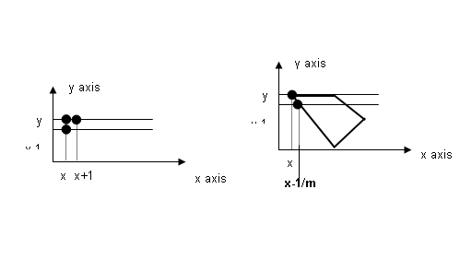
For any scan line, adjacent horizontal positions across the line differ by 1, and a vertical y value on an adjacent scan line differs by 1. If the depth of position (x, y) has been determined to be z, then the depth z’ of the next position (x+1, y) along the scan line y is obtained as given below:

Slide 13
Algorithm
The steps of a depth-buffer algorithm are summarized below:
Initialize the depth buffer and refresh buffer to depth(x,y) = 0 and refresh(x,y) = I_{backgnd}.
For each position on each polygon surface, compare depth values to previously stored values in the depth buffer to determine visibility.
Calculate depth z for each (x,y) position on each polygon surface.
if (z > depth(x,y), then set depth(x,y) = z and refresh(x,y) = I_{surface}(x,y)
where I_{backgnd} is the value for background intensity and I_{surface} is intensity value of surface at point (x,y).
After all surfaces have been processed, the depth buffer contains depth values for the visible surfaces and the refresh buffer contains the corresponding intensity values for those surfaces.
The depth-buffer method is very easy to implement but it does require the availability of a second buffer in addition to the refresh buffer.

Slide 14
Advantages:
It is easy to implement.
It reduces the speed problem if implemented in hardware.
It processes one object at a time
Disadvantages:
It requires large memory
It is a time consuming process as it requires comparison for each pixel instead of for the entire polygon.
Deals only with opaque object but not for transparent object

Slide 15
A-Buffer Method

Slide 16
An extension of the ideas in the depth-buffer method
The origin of this name
At the other end of the alphabet from “z-buffer”
Antialiased, area-averaged, accumulation-buffer
A drawback of the depth-buffer method
Deals only with opaque surfaces
Can’t accumulate intensity values
for more than one surface
Foreground
transparent surface
Background
opaque surface

Slide 17
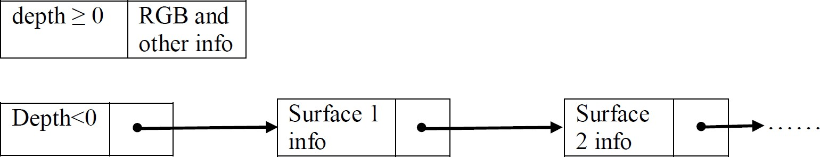
It consists of accumulation(A) buffer which as two fields: a)Depth field: It stores a positive or negative real number. b)Intensity field: It stores surface data or a pointer value
Organization of an A-buffer pixel position :
(a) single-surface overlap (b) multiple-surface overlap
If depth field is non negative (>=0), it indicates single surface. The intensity field then stores the RGB components of the surface color at that point and the percent of pixel coverage.
If depth is negative (<0) it indicates multiple surface. The intensity field then stores a pointer to a linked list of surface data.
.

Slide 18
Surface information in A-buffer includes:
Depth - Surface identifier
Percentage of area coverage
Pointer to the next surface
Opacity parameter
RGB intensity component
Advantage:
It provides anti-aliasing in addition to what Z-buffer does.
Disadvantage:
It is slightly costly than Z-buffer method because it requires more memory in comparison to the Z-buffer method.

Slide 19
Scan-Line Method

Slide 20
Extension of the scan-line algorithm for filling polygon interiors.
Image Space Method
Edge table
Coordinate endpoints for each line
Slope of each line
Pointers into the polygon table
Identify the surfaces bounded by each line
Polygon table
Coefficients of the plane equation for each surface
Intensity information for the surfaces
Pointers into the edge table

Slide 21
Active list
Contain only edges across the current scan line
Sorted in order of increasing x
Flag for each surface
Indicate whether inside or outside of the surface
At the leftmost boundary of a surface
The surface flag is turned on
At the rightmost boundary of a surface
The surface flag is turned off

Slide 22
Example
Active list for scan line 1
Edge table
AB, BC, EH, and FG
Between AB and BC, only
the flag for surface S₁ is on
No depth calculations are necessary
Intensity for surface S₁ is entered into the refresh buffer
Similarly, between EH and FG, only the flag for S₂ is on

Slide 23
For scan line 2, 3
AD, EH, BC, and FG
Between AD and EH, only the flag for S₁ is on
Between EH and BC, the flags for both surfaces are on
Depth calculation is needed
Intensities for S₁ are loaded into the refresh buffer until BC
Take advantage of coherence
Pass from one scan line to next
Scan line 3 has the same active list as scan line 2
Unnecessary to make depth calculations between EH and BC

Slide 24
Scan-Line Method Basic Example
Scan Line 1:
(A,B) to (B,C) only inside S₁, so color from S₁
(E,H) to (F,G) only inside S₂, so color from S₂
Scan Line 2:
(A,D) to (E,H) only inside S₁, so color from S₁
(E,H) to (B,C) inside S₁ and S₂ , so compute & test depth In this example we color from S₁
(B,C) to (F,G) only inside S₂, so color from S₂
B
E
F
Scan Line 1
A
S₁
S₂
Scan Line 2
Scan Line 3
H
C
D
G

Slide 25
Algorithm
Set up an Active Edge list and assign flag for each surface.
For each scan line:
Update the active edge list in increasing order of x for the scan line at position y.
Start scanning from left to right.
If one flag is ON, assign refresh buffer at that position with the intensity information of the corresponding polygon surface.
If two or more flags are ON at the same time, do depth calculations of each surface and assign the refresh buffer at that position with the intensity of the surface having minimum depth.

Slide 26
Drawback
This basic approach fails when surfaces cut-through each other or overlap. To generalize we must divide surfaces to eliminate overlaps

Slide 27
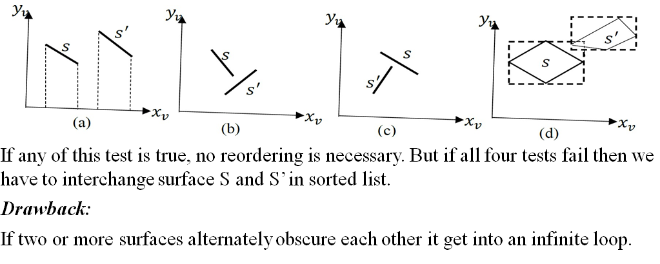

Slide 28
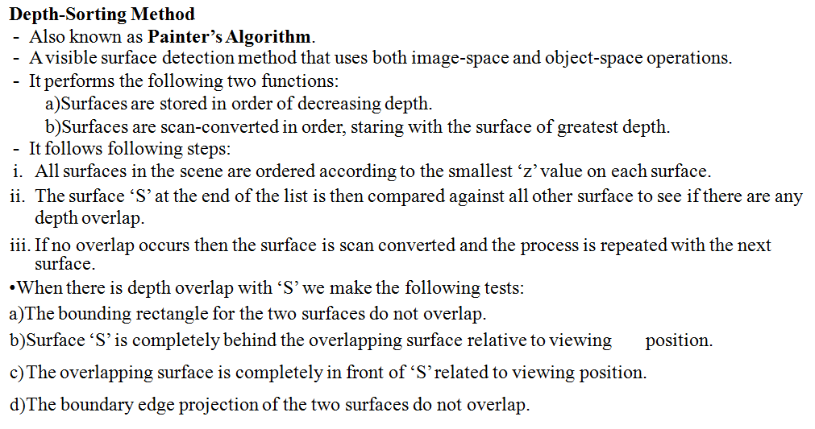

Slide 29
Surface Reordering
If all four tests fail with S’
Interchange surfaces S and S’ in the sorted list
Repeat the tests for each surface that is reordered in the list
S
S’’
S’
S
S’
x_{v}
x_{v}
z_{v}
<S ←→ S’>
z_{v}
<S ←→ S’’, then S’’ ←→ S’>

Slide 30
BSP-Tree Method

Slide 31
Characteristics
Binary Space-Partitioning(BSP) Tree
Determining object visibility by painting surfaces onto the screen from back to front
Like the painter’s algorithm
Particularly useful
The view reference point changes
The objects in a scene are at fixed positions

Slide 32
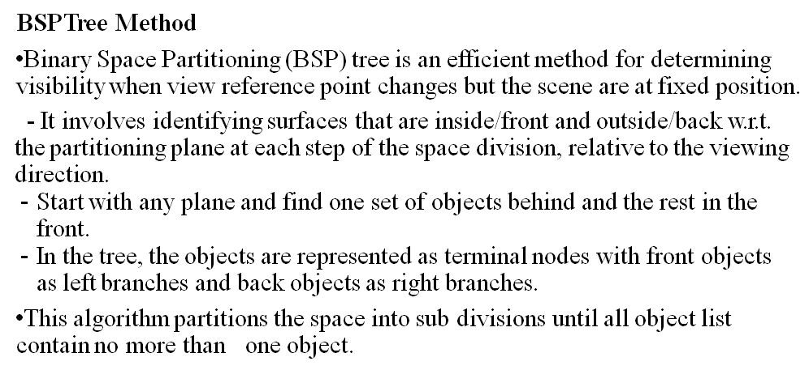
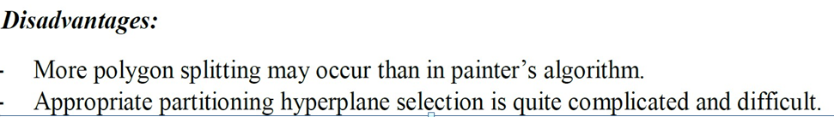

Slide 33
Process
Identifying surfaces
“inside” and “outside” the partitioning plane
Intersected object
Divide the object into two separate objects(A, B)
P₂
P₁
P₁
C
front
back
D
A
P₂
P₂
front
back
front
back
B
front
back
A
C
B
D
back
front

Slide 34
Area-Subdivision Method

Slide 35
Characteristics
Takes advantage of area coherence
Locating view areas that represent part of a single surface
Successively dividing the total viewing area into smaller rectangles
Until each small area is the projection of part of a single visible surface or no surface
Require tests
Identify the area as part of a single surface
Tell us that the area is too complex to analyze easily
Similar to constructing a quadtree

Slide 36
Process
Staring with the total view
Apply the identifying tests
If the tests indicate that the view is sufficiently complex
Subdivide
Apply the tests to each of the smaller areas
Until belonging to a single surface
Until the size of a single pixel
Example
With a resolution 1024 × 1024
10 times before reduced to a point

Slide 37
Identifying Tests
Four possible relationships
Surrounding surface
Completely enclose the area
Overlapping surface
Partly inside and partly outside the area
Inside surface
Outside surface
No further subdivisions are needed if one of the following conditions is true
All surface are outside surfaces with respect to the area
Only one inside, overlapping, or surrounding surface is in the area
A surrounding surface obscures all other surfaces within the area boundaries → from depth sorting, plane equation
Surrounding
Surface
Overlapping
Surface
Inside
Surface
Outside
Surface

Slide 38
Octree Method

Slide 39
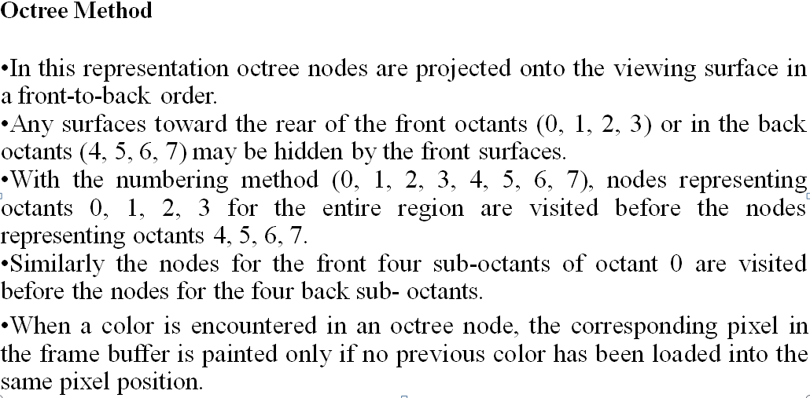

Slide 40
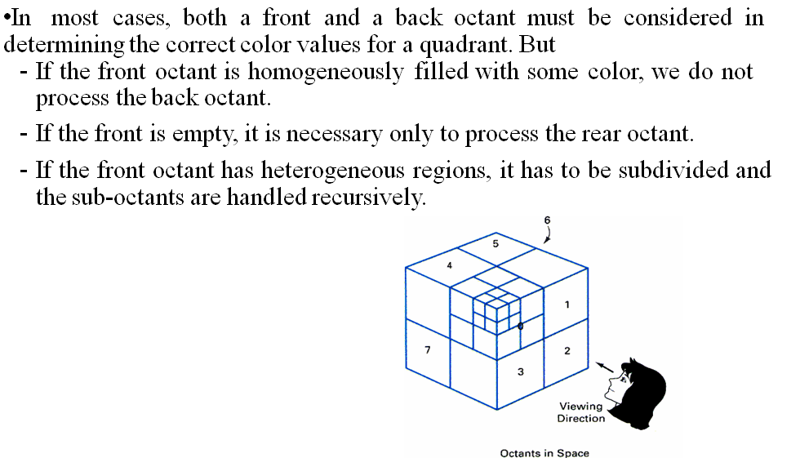

Slide 41
Characteristics
Extension of area-subdivision method
Projecting octree nodes onto the viewplane
Front-to-back order ←→ Depth-first traversal
The nodes for the front suboctants of octant 0 are visited before the nodes for the four back suboctants
The pixel in the framebuffer is assigned that color if no values have previously been stored
Only the front colors are loaded
6
4
5
0
1
7
3
2

Slide 42
Displaying An Octree
Map the octree onto a quadtree of visible areas
Traversing octree nodes from front to back in a recursive procedure
The quadtree representation for the
visible surfaces is loaded into the
framebuffer
6
5
4
1
0
7
2
3
Octants in Space

Slide 43
Ray-Casting Method

Slide 44
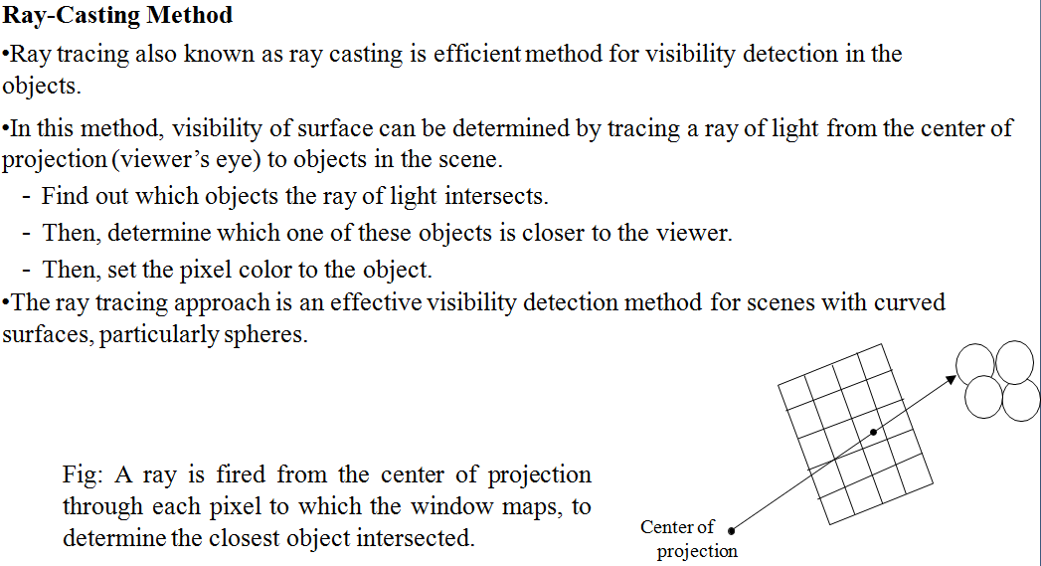

Slide 45
Characteristics
Based on geometric optics methods
Trace the paths of light rays
Line of sight from a pixel position on the viewplane through a scene
Determine which objects intersect this line
Identify the visible surface whose intersection point is closest to the pixel
Infinite number of light rays
Consider only rays that pass through pixel positions
Trace the light-ray paths backward from the pixels
Effective visibility-detection method
For scenes with curved surfaces

Slide 46
Image-Space Method vs. Object-Space Method
Image-Space Method
Depth-Buffer Method
A-Buffer Method
Scan-Line Method
Area-Subdivision Method
Object-Space Method
Back-Face Detection
BSP-Tree Method
Area-Subdivision Method
Octree Methods
Ray-Casting Method

Slide 47
Characteristics
In wireframe display
Visibility tests are applied to surface edges
Visible edge sections are displayed
Hidden edge sections can be eliminated or displayed differently from the visible edges
Procedures for determining visibility of edges
Wireframe-visibility(Visible-line detection, Hidden-line detection) methods

Slide 48
Comparison of visibility-detection methods
Effectiveness of method depends on surface distribution
wide distribution along view depth implies little depth overlap. This is ideal for depth-sorting and BSP-trees
few overlaps in surface view plane projections is ideal for scan-line or area-subdivision
More generally
few surfaces implies few depth overlaps which is ideal for depth-sort or BSP-tree
scan-line also good for a few thousand polygon surfaces
for large number of surfaces octree or depth-buffer is better
depth-buffer – tends to have constant computation cost as # of surfaces increases because more surfaces tends to imply individual surfaces are small (but beware of depth-complexity). Relative performance best for complex scenes.
Octree – for parallel projection of volume data only need integer add/sub. operations

Slide 49
Summary

Slide 50
Comparison(1 / 2)
Back-face detection methods
Fast and effective as an initial screening
Eliminate many polygons from further visibility tests
In general, this can’t completely identify all hidden surfaces
Depth-buffer(z-buffer) method
Fast and simple
Two buffers
Refresh buffer for the pixel intensities
Depth buffer for the depth of the visible surface

Slide 51
Comparison(2 / 2)
A-buffer method
An improvement on the depth-buffer approach
Additional information
Antialiased and transparent surfaces
Other visible-surface detection schemes
Scan-line method
Depth-sorting method(painter’s algorithm)
BSP-tree method
Area subdivision method
Octree methods
Ray casting

